Slide 1
ROYAL SMILES

Slide 2
DIAGNOSIS
1.DECAY
2.BLEEDING GUMS 9. PRE CANCEROUS LESION
3.PERIODONTAL PROBLEMS 10.FRACTURE
4.ORAL MALODOUR
5.EDENTULISM
6.MALOCCLUSION
7.TOOTH ABSCESS
8.WASTING DISEASES

Slide 3
TREATMENT
AMALGAM RESTORATION | FPD
COMPOSITE RESTORATION | SCALING AND ROOT PLANING
RCT | PREVENTIVE MEASURES
EXTRACTION | ORTHODONTIC CORRECTION
FLAP SURGERY | SURGICAL EXCISION/BIOPSY
GIC
DENTURES
IMPLANT

Slide 4
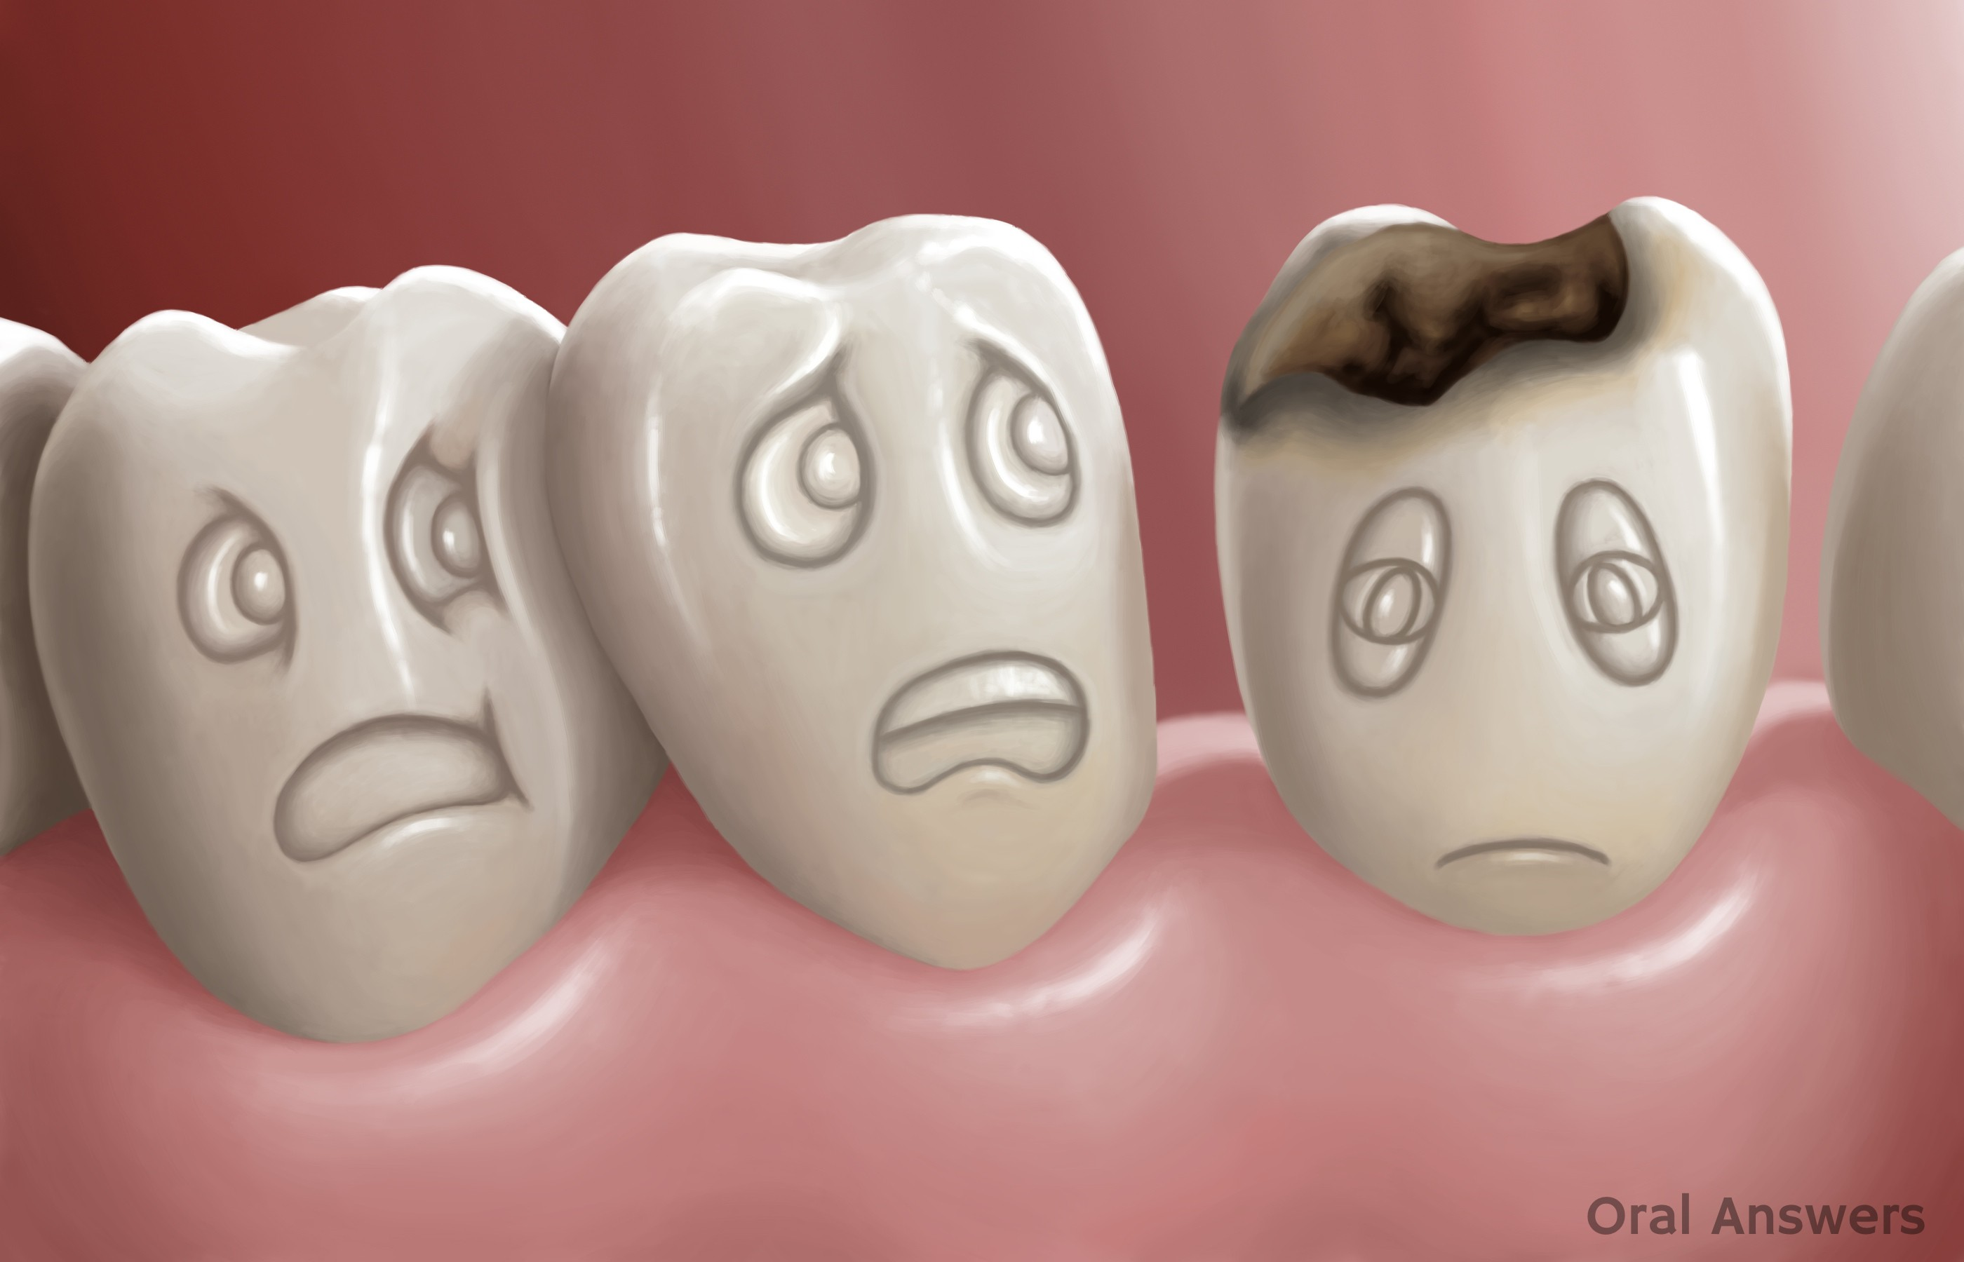
DENTAL CARIES
Breakdown of teeth due to activities of bacteria
1

Slide 5
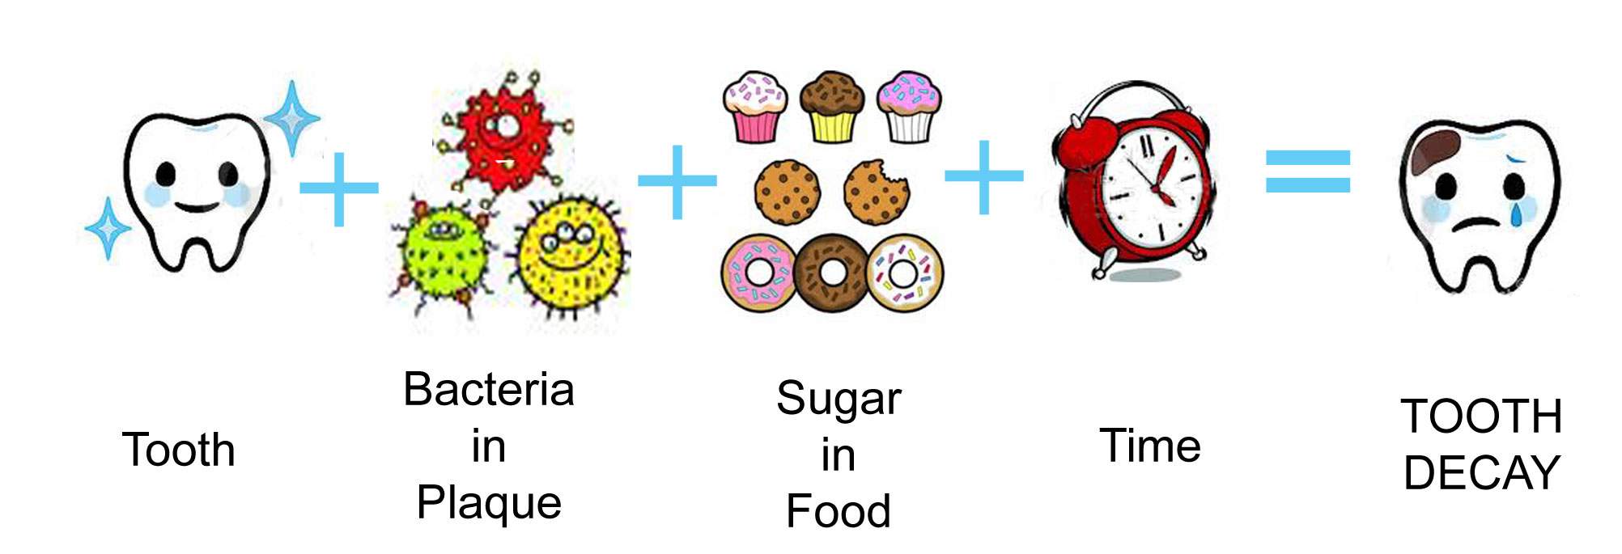
CARIES PROCESS:
2

Slide 6
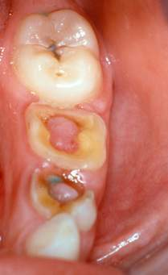
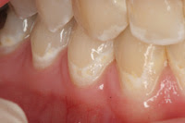
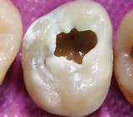
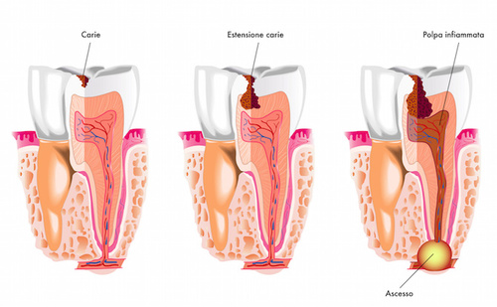
3
4
5
ENAMEL DECAY
DENTINAL DECAY
PULPAL INVOLVEMENT
6
Enamel caries
Dentinal caries
Pulpal involvement
ABSCESS

Slide 7
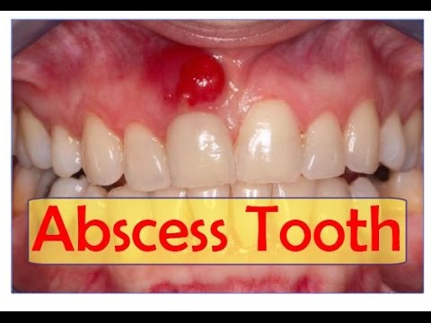
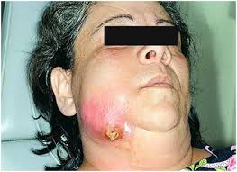
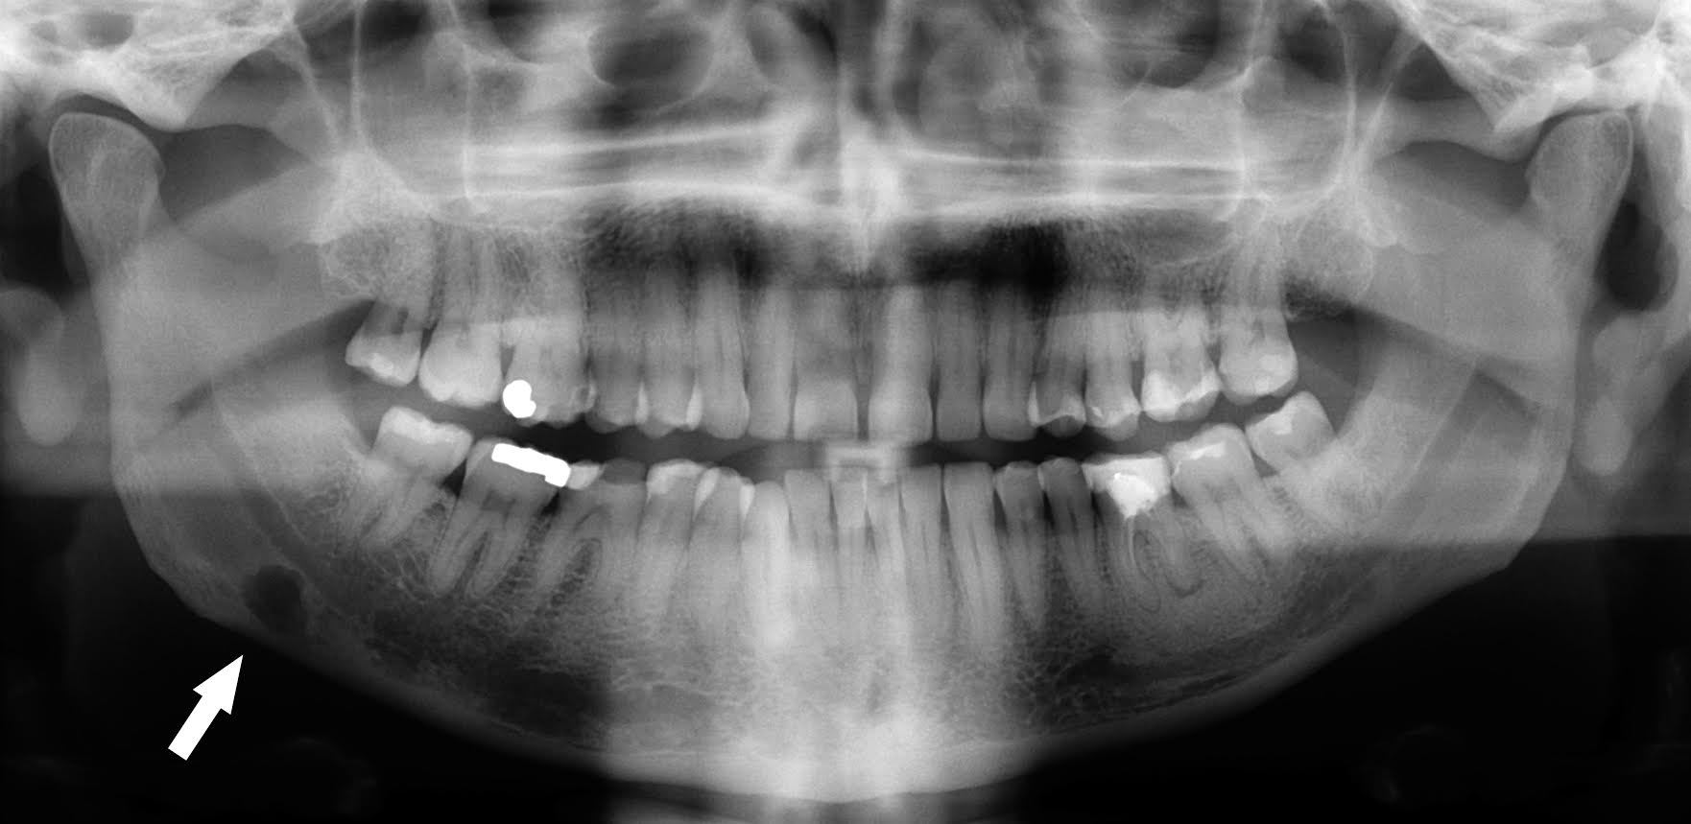
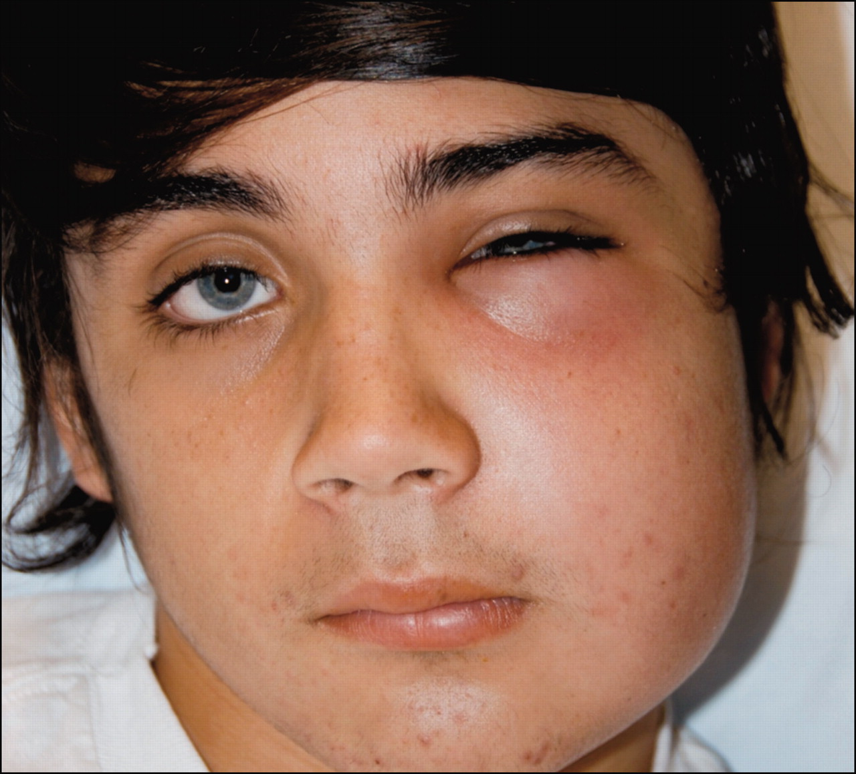
ENAMEL CARIES
DENTINAL CARIES
PULPITIS
TOOTH ABSCESS
SINUS OPENING
7
8
9
10
11
12
13
OSTEOMYELITIS
CELLULITIS

Slide 8
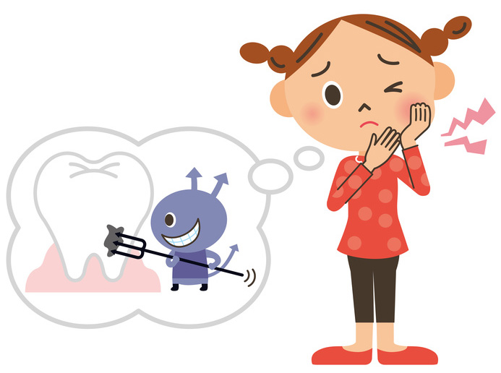
Don’t Wait Until it Hurts…
14
TREATMENT
PREVENTION

Slide 9
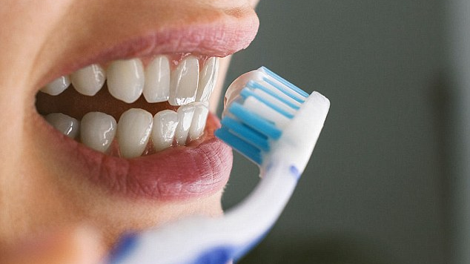
MODIFIED BASS METHOD
15

Slide 10
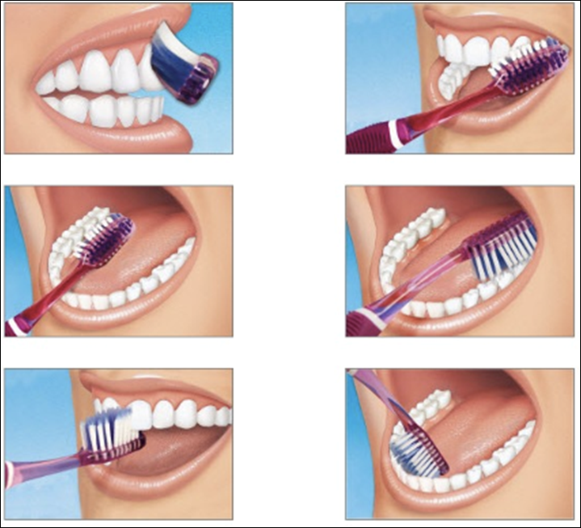
16

Slide 11
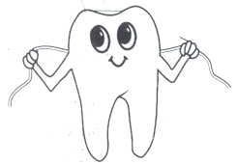
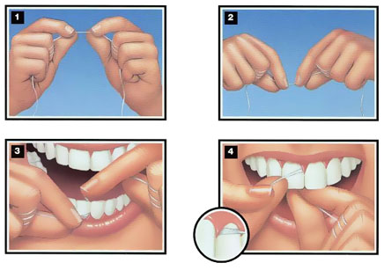
21
Dental floss
17
20

Slide 12
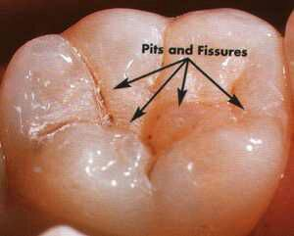
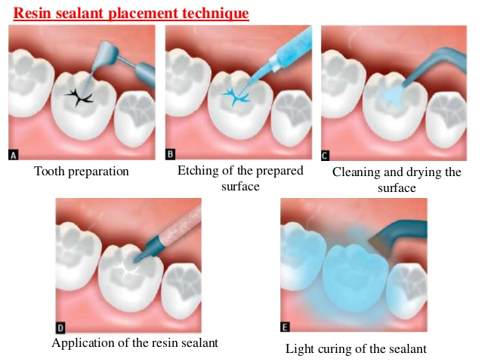
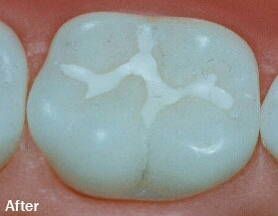
SEALANT APPLICATION
23
22
24

Slide 13
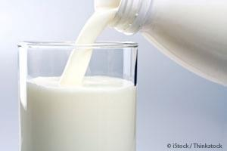
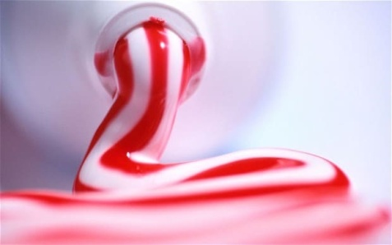

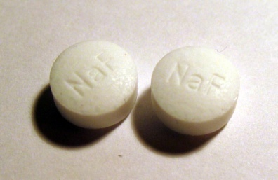

FLUORIDE supplements
26
27
25
FLUORIDE
29
28

Slide 14
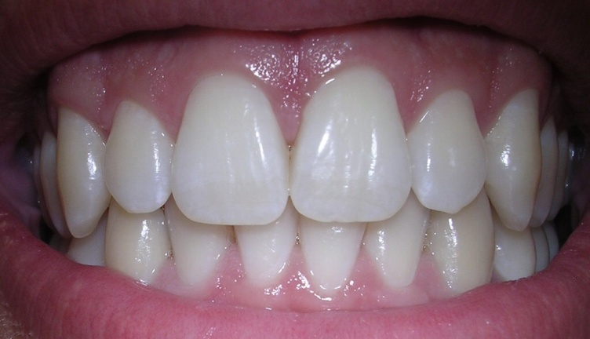
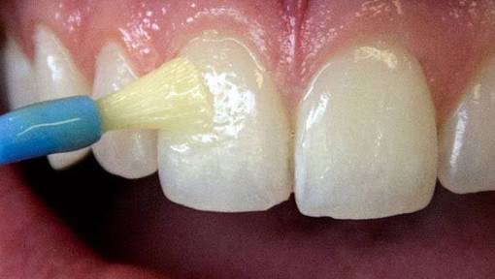
FLUORIDE APPLICATION
31
30

Slide 15
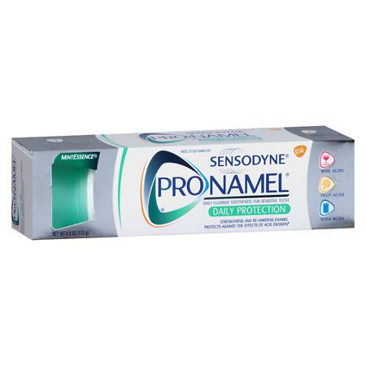
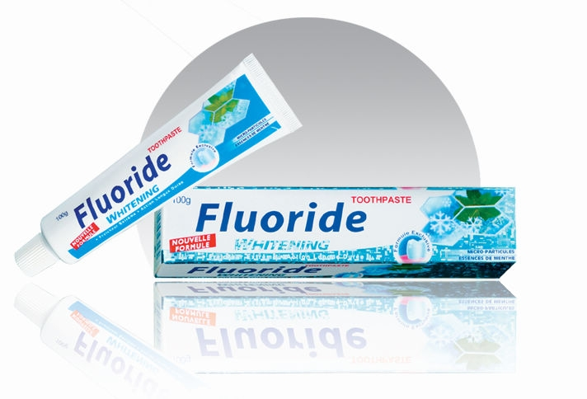
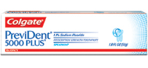
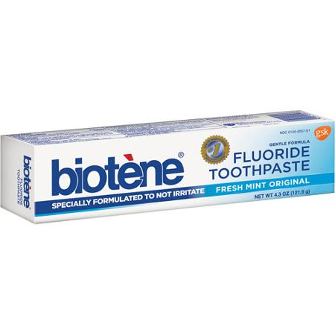
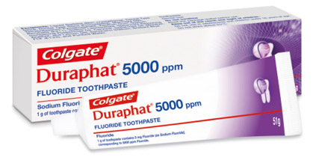
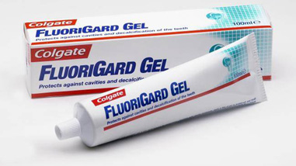
FLUORIDE TOOTHPASTES
33
32
34
35
37
36

Slide 16
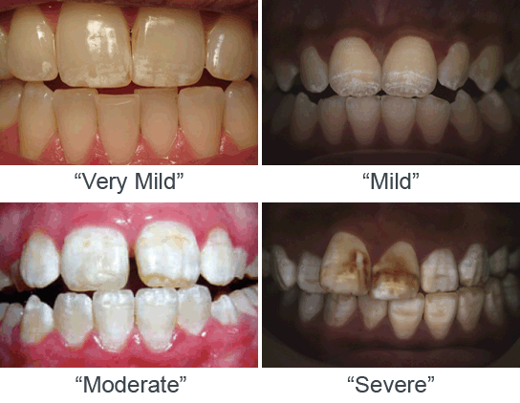
EXCESS FLUORIDE
38

Slide 17
TREATMENT
AMALGAM RESTORATION
RCT
COMPOSITE RESTORATION
EXTRACTION

Slide 18
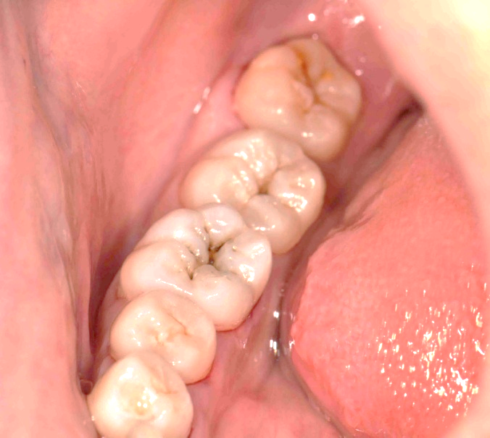
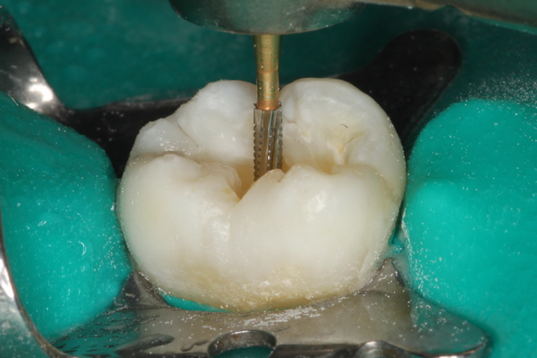
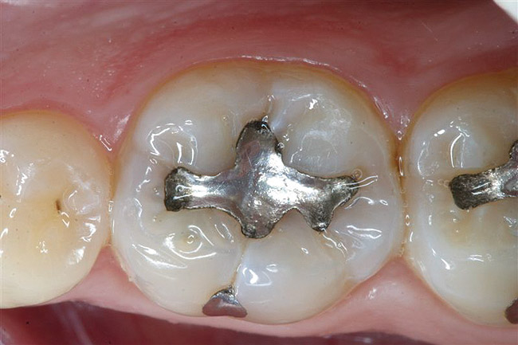
AMALGAM RESTORATION
39
40
41
DENTAL CARIES
CAVITY PREPARATION
AMALGAM RESTORATION

Slide 19
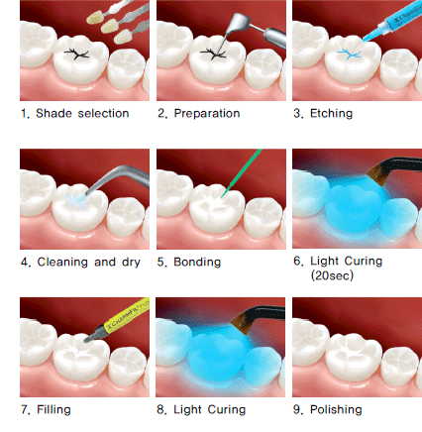
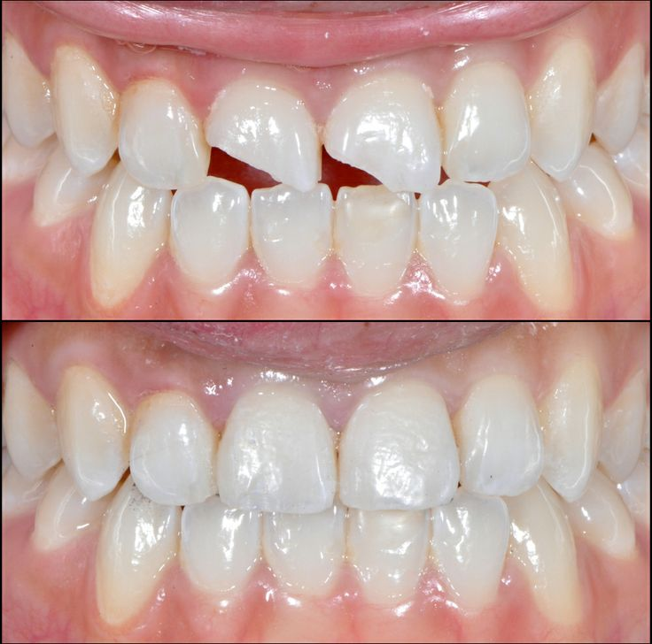
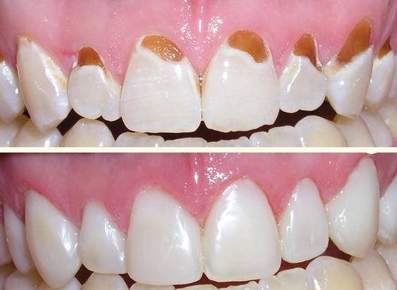
COMPOSITE RESTORATION
42
43
44

Slide 20
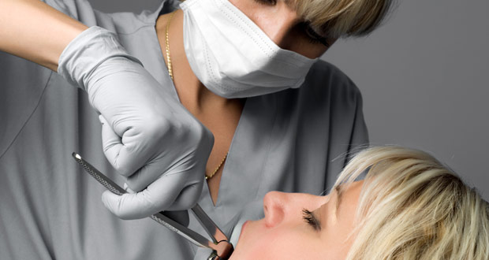
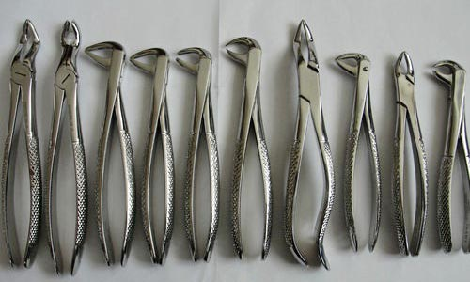
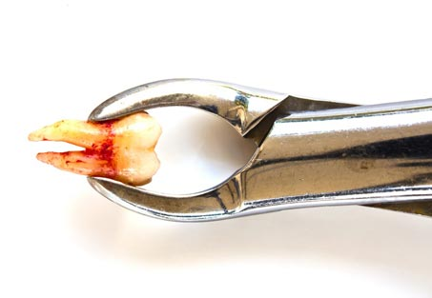
EXTRACTION
46
45
Extraction forceps
47

Slide 21
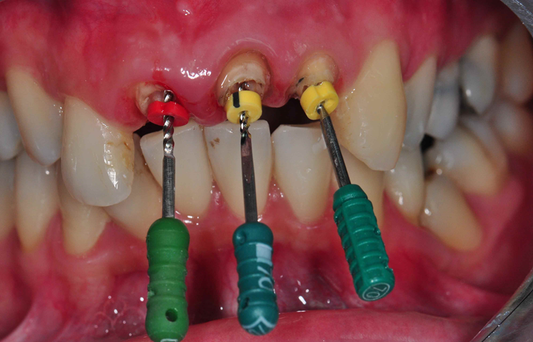
ROOT CANAL TREATMENT
48

Slide 22
WASTING DISEASES
ATTRITION
ABRASION
EROSION
ABFRACTION

Slide 23
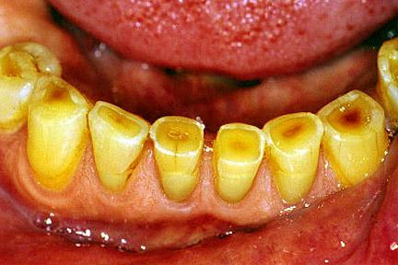
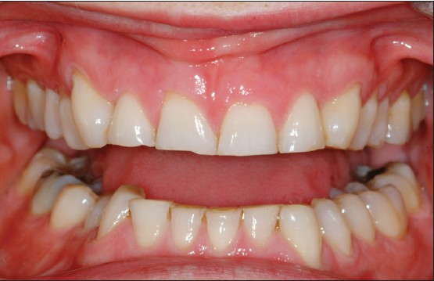
ATTRITION
49
CLINICAL FEATURES
Small polished facet on a cusp or ridge/flattening of incisal edge
Shortened height of teeth
Staining and sensitivity in advanced cases
Causes-bruxism
trauma from occlusion
50
TREATMENT

Slide 24
TREATMENT
REMOVE THE CAUSE
TREATMENT OF HYPERSENSITIVITY
SEVERE-INTENTIONAL RCT AND CROWN PLACEMENT

Slide 25
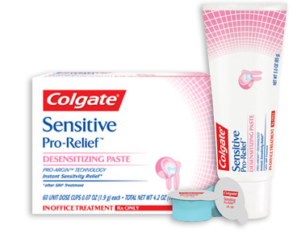
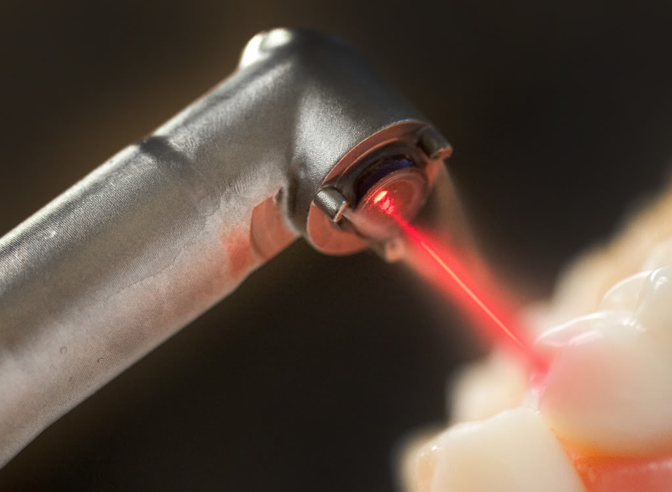
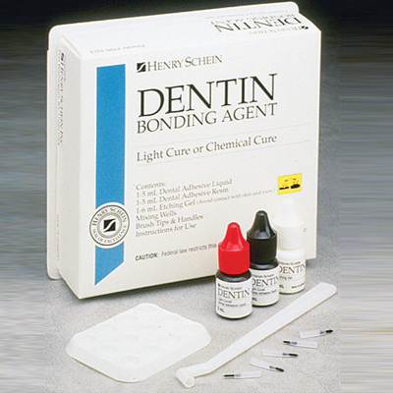
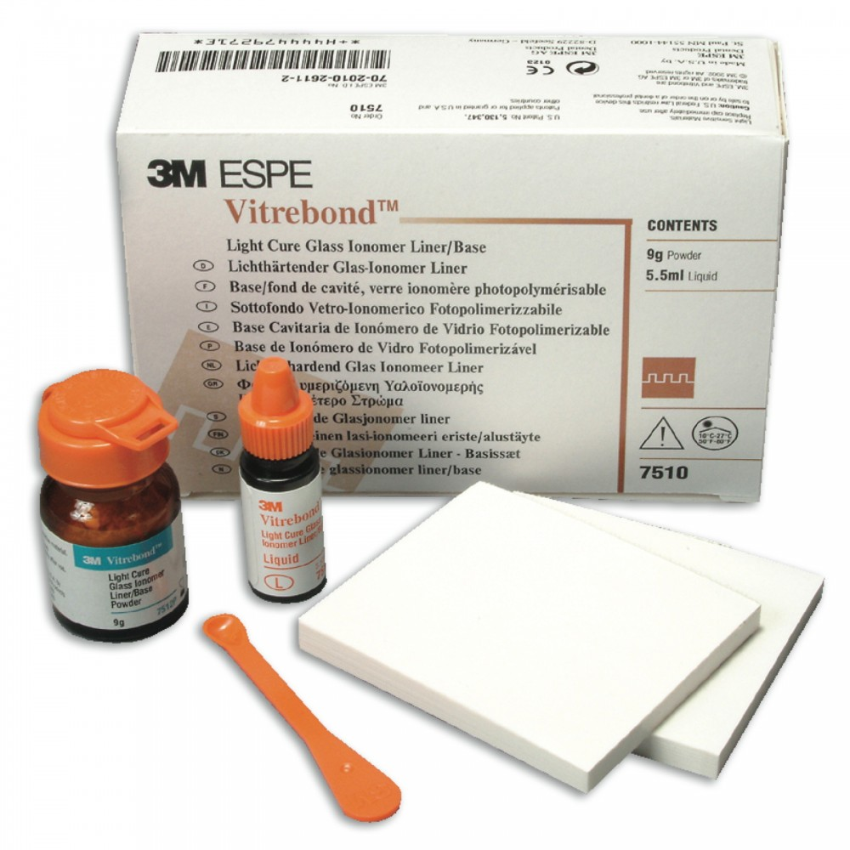
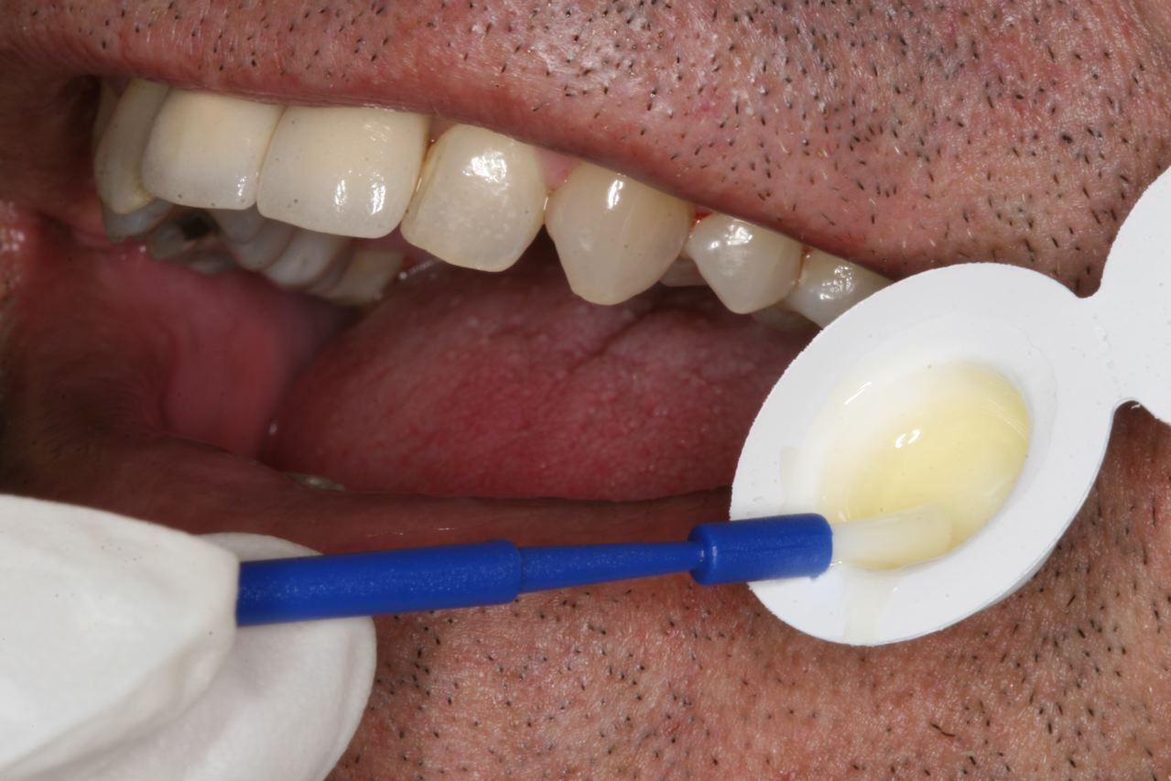
DENTIN HYPERSENSITIVITY
52
53
51
DESENSITISING PASTE
LASER
COMPOSITE
55
56
54
FLUORIDE SEALER
DENTIN BONDING AGENTS
GLASS IONOMER CEMENT

Slide 26
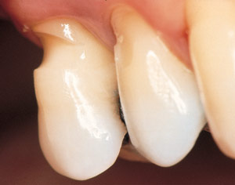
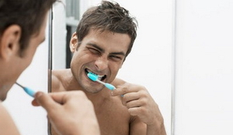
ABRASION
57
CLINICAL FEATURES
V-shaped/wedge shaped ditch on the root side of CEJ
Exposed dentin appears polished
Sensitivity
Causes-abrasive dentifrice
improper toothbrushing
habits/occupational
58
TREATMENT

Slide 27
1.COMPOSITE 2.GIC

Slide 28
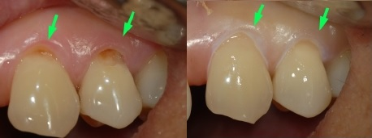
GIC
59
60

Slide 29

EROSION
61
CLINICAL FEATURES
By action of chemicals
Wear on non occluding surfaces
Hypersensitivity
Increased incisal translucency
Causes-intrinsic→GERD(gastroesophageal reflux disease,excess vomiting
extrinsic→acidic beverages,foods,medications
TREATMENT

Slide 30
TREATMENT
REMOVAL OF CAUSE
HYPERSENSITIVITY
RCT AND CROWN

Slide 31

ABFRACTION
62
CLINICAL FEATURES
Deep,V-shaped notch
Affects buccal/labial cervical areas
Affects single teeth with eccentric occlusal loads
TREATMENT

Slide 32
1.COMPOSITE
2. GIC

Slide 33



ORAL MALODOUR
63
64
CAUSES
Poor Oral Hygiene
Periodontal Infection
Unclean Dentures
Dental Abscess And Caries
Faulty Restoration
Food Impaction
Nasal Infections
Gastro Intestinal Diseases
Pulmonary Infections
Systemic Diseases
65

Slide 34


TREATMENT
67
66

Slide 35
DENTAL FLOSS

Slide 36

GINGIVITIS
Gum inflammation
Characterised by bleeding
68
TREATMENT

Slide 37
TREATMENT
Oral prophylaxis
Scaling
Root planing

Slide 38


ORAL PROPHYLAXIS
SCALING
ROOT PLANING
69
70

Slide 39

PERIODONTAL DISEASE
71

Slide 40











CAUSES
77
72
79
75
78
80
73
76
82
81
74

Slide 41





84
Effects of smoking on Periodontium
85
83
87
86

Slide 42










SIGNS & SYMPTOMS
89
88
93
94
90
95
91
92
96
97

Slide 43






Acute Necrotising Ulcerative Gingivitis(Trench Mouth)
98
99
100
102
103
101

Slide 44







AGGRESSIVE PERIODONTITIS
104
Risk factors
1.Immunologic factors
3.Environmental factors
TREATMENT
105
106
107
4.stress
5.smoking
2.Genetic factors
109
110
108

Slide 45






112
113
111
116
114
115

Slide 46







118
117
FLAP SURGERY
119
120
121
122
123

Slide 47
BRUSHING TECHNIQUE

Slide 48

MODIFIED STILLMAN
124

Slide 49

125

Slide 50




126
127
128
129

Slide 51

130
CHARTER METHOD

Slide 52


131
132

Slide 53

133

Slide 54
ORAL PROPHYLAXIS

Slide 55
DENTAL FLOSS

Slide 56






136
PRECANCEROUS LESIONS
LEUKOPLAKIA
ERYTHROPLAKIA
ACTINIC CHELITIS
134
PRECANCEROUS CONDITIONS
ORAL SUBMUCOUS FIBROSIS
SIDEROPENIC DYSPHAGIA
LICHEN PLANUS
135
137
139
138
PRECANCEROUS LESIONS &CONDITIONS

Slide 57







ORAL CANCER
140
142
143
141
145
144
146

Slide 58


BIOPSY
148
147

Slide 59
149
TOOTH ABSCESS

Slide 60
SIGNS AND SYMPTOMS
SWELLING
FEVER
TOOTH ACHE
PUS DISCHARGE
150
151
152
153

Slide 61





155
156
154
C0MPLICATION
157
158
159

Slide 62




MANAGEMENT
160
161
INCISION AND DRAINAGE
162
163

Slide 63

INCISION AND DRAINAGE
164

Slide 64




EDENTULISM
165
166
Tooth loss
Causes-decay
periodontal disease
trauma
congenital
167
168
TREATMENT

Slide 65






170
171
169
FIXED - BRIDGE
REMOVABLE - COMPLETE DENTURE
REMOVABLE-TEMPORARY PARTIAL DENTURE
173
174
172
FIXED – CAST PARTIAL DENTURE
FIXED - IMPLANT AND BRIDGE
FIXED - IMPLANT SUPPORTED COMPLETE DENTURE

Slide 66


MALOCCLUSION
Misalignment or incorrect relation between teeth
175
176
TREATMENT

Slide 67
TREATMENT
ORTHODONTIC-TOOTH MOVEMENT
REMOVABLE
FIXED
MYOFUNCTIONAL
ORTHOPEDIC-GROWTH MODIFICATION OF SKELETAL PATTERN

Slide 68



ORTHODONTIC
177
178
179
REMOVABLE
FIXED
MYOFUNCTIONAL

Slide 69



ORTHOPEDIC
181
182
180

Slide 70
TOOTH FRACTURE

Slide 71

ELLIS CLASS I
Crown fracture involving enamel only
183
TREATMENT

Slide 72
Treatment
Composite restoration

Slide 73

ELLIS CLASS II
Crown fracture involving dentin
184
TREATMENT

Slide 74
Treatment
Composite restoration

Slide 75

ELLIS CLASS III
Crown fracture exposing the pulp
185
TREATMENT

Slide 76
RCT EXTRACTION

Slide 77

ELLIS CLASS IV
Non vital tooth
186
TREATMENT

Slide 78
RCT
EXTRACTION

Slide 79

CLASS V
Avulsion of tooth
187
TREATMENT

Slide 80


Treatment IMPLANT FPD
189
188

Slide 81

CLASS VI
Root fracture with or without crown fracture
190
TREATMENT

Slide 82
Treatment
EXTRACTION

Slide 83

ELLIS VII
Displacement of the tooth
191
TREATMENT

Slide 84

Treatment
Splint and realign with orthodontic therapy
192

Slide 85

CLASS VIII
Crown en mass
193
TREATMENT

Slide 86

IMPLANT/CROWN LENGTHENING
194

Slide 87

CLASS IX
Fracture of deciduous tooth
195
TREATMENT

Slide 88
Treatment
EXTRACTION
COMPOSITE

